Slide 1

What’s new in FakeXrmEasy (with .net core 3.1)
What’s new in v2.x of FakeXrmEasy
1

Slide 2






WhoAmIRequest ...
@jordimontana
@jordimontana82
https://www.linkedin.com/in/jordimontana/
What’s new in FakeXrmEasy v2.x
1

Slide 3
Why...
...Unit Testing?
What’s new in FakeXrmEasy v2.x
1

Slide 4
Why...
...Fixing a bug in Production...
What’s new in FakeXrmEasy v2.x
1

Slide 5
* Proactive as opposed to Reactive
* Bring issues closer to devs (us), where they’re easier and more cost efficient to fix
Why...
...Unit Testing?
What’s new in FakeXrmEasy v2.x
1

Slide 6




What is FakeXrmEasy?
https://github.com/jordimontana82/fake-xrm-easy
OSS Framework
177 Stars
140 forks
Aimed at developers using .net and Power Platform / CDS
Forks are like “copies” of the project
46 contributors
5+ Years
800k downloads
Who submitted at least 1 Pull Request
Started back in November 2014… time flies
Not too bad for a “low code” platform :)
What’s new in v2.x of FakeXrmEasy
1

Slide 7






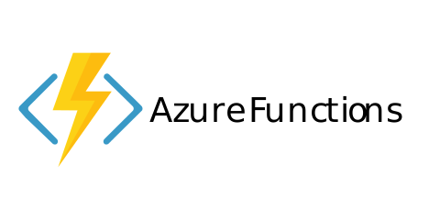
#UnlimitedPower!
Cross-platform dev
What’s new in v2.x ...
.net core 3.1
Containerisation / Orchestration
Serverless
https://github.com/microsoft/PowerPlatform-CdsServiceClient (alpha release… you’ve been warned)
What’s new in FakeXrmEasy v2.x
1

Slide 8
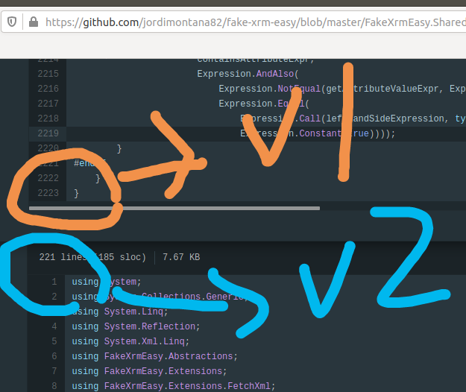
* Use the right abstraction layer
* Install what you need only
* Massive refactorings
- FakeXrmEasy.Abstractions
- FakeXrmEasy.Core
- FakeXrmEasy.Plugins
- FakeXrmEasy.CodeActivities
- FakeXrmEasy.Integration
- FakeXrmEasy.Messages.Cds
- FakeXrmEasy.Messages.Sales ...
What’s new in v2.x ...
1 NuGet Package (v1.x) →
~ 6 NuGet Packages (v2.x)
What’s new in FakeXrmEasy v2.x
<number>

Slide 9
* Use the right abstraction layer
* Install what you need only
* Massive refactorings
- FakeXrmEasy.Abstractions
- FakeXrmEasy.Core
- FakeXrmEasy.Plugins
- FakeXrmEasy.CodeActivities
- FakeXrmEasy.Integration
- FakeXrmEasy.Messages.Cds
- FakeXrmEasy.Messages.Sales ...
What’s new in v2.x ...
1 NuGet Package (v1.x) →
~ 6 NuGet Packages (v2.x)
What’s new in FakeXrmEasy v2.x
<number>

Slide 10
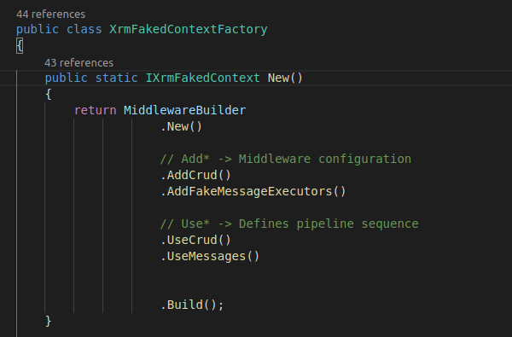
* There was up to 1 FakeMessageExecutor per OrganizationRequest in v1.x
* Now each OrganizationRequest runs through a configurable pipeline
* Much more decoupled and extensible implementation
What’s new in v2.x
New Middleware
<number>

Slide 11
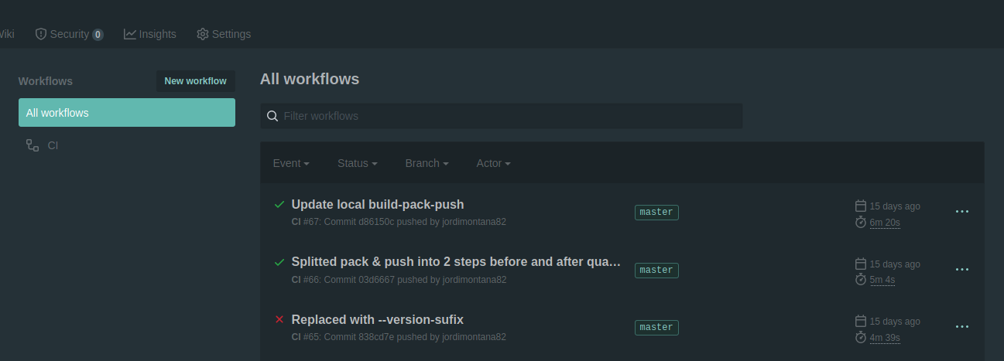
* Using AppVeyor in v1.x
* GitHub Actions in v2: Built-in / integrated workflow
What’s new in v2.x
GitHub Actions
What’s new in FakeXrmEasy v2.x
<number>

Slide 12
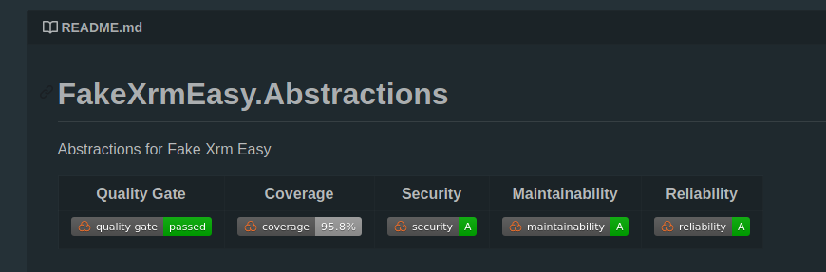
* Consistent Conventions / Rules across Pull Requests
* OWASP built-in checks (security)
* Code Smells
What’s new in v2.x
Sonar Quality Gate
What’s new in FakeXrmEasy v2.x
<number>

Slide 13
What’s new in v2.x
DEMO
What’s new in FakeXrmEasy v2.x
<number>

Slide 14

THANK YOU!
Fill out survey: https://bit.ly/2A9VfiY

